Slide 1
Graph & BFS
Lecture 22

Slide 2
Graphs
Extremely useful tool in modeling problems
Consist of:
Vertices
Edges
Vertices can be considered “sites” or locations.
Edges represent
connections.
D
E
C
A
F
B
Vertex
Edge

Slide 3
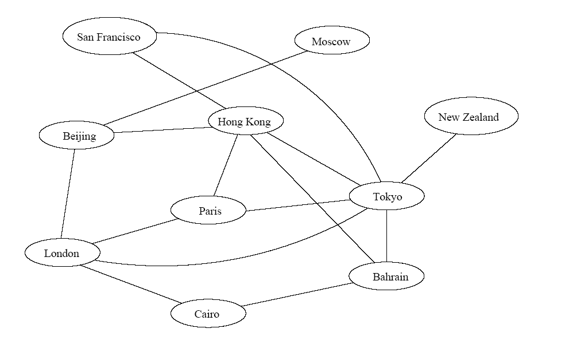
Application 1
Air flight system
Each vertex represents a city
Each edge represents a direct flight between two cities
A query on direct flights = a query on whether an edge exists
A query on how to get to a location = does a path exist from A to B
We can even associate costs to edges (weighted graphs), then ask “what is the cheapest path from A to B”

Slide 4
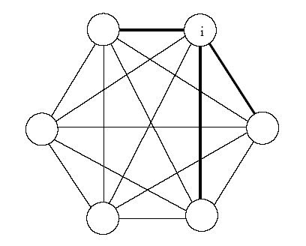
Application 2
Wireless communication
Represented by a weighted complete graph (every two vertices are connected by an edge)
Each edge represents the Euclidean distance dij between two stations
Each station uses a certain power i to transmit messages. Given this power i, only a few nodes can be reached (bold edges). A station reachable by i then uses its own power to relay the message to other stations not reachable by i.
A typical wireless communication problem is: how to broadcast between all stations such that they are all connected and the power consumption is minimized.

Slide 5
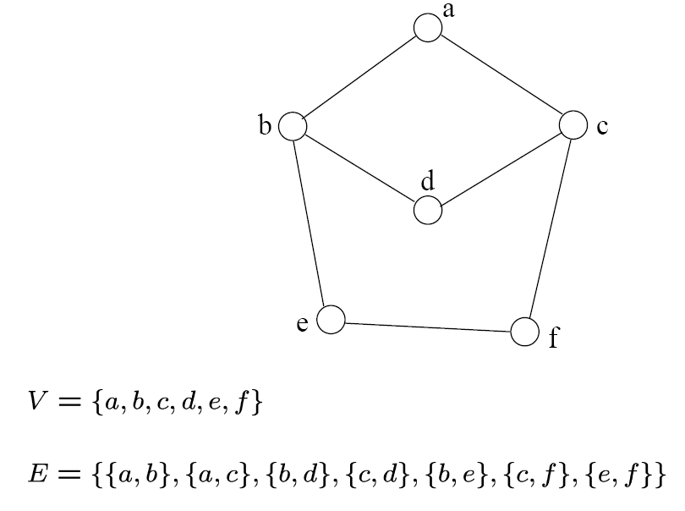
Definition
A graph G=(V, E) consists a set of vertices, V, and a set of edges, E.
Each edge is a pair of (v, w), where v, w belongs to V
If the pair is unordered, the graph is undirected; otherwise it is directed
{a,b}
{a,c}
{b,d}
{c,d}
{b,e}
{c,f}
{e,f}
An undirected graph

Slide 6
Terminology
If v₁ and v₂ are connected, they are said to be adjacent vertices
v₁ and v₂ are endpoints of the edge {v₁, v₂}
If an edge e is connected to v, then v is said to be incident on e. Also, the edge e is said to be incident on v.
{v₁, v₂} = {v₂, v₁}
If we are talking about directed graphs, where edges have direction. This means that {v₁,v₂} ≠ {v₂,v₁} . Directed graphs are drawn with arrows (called arcs) between edges.
A
B
This means {A,B} only, not {B,A}

Slide 7
Graph Representation
Two popular computer representations of a graph. Both represent the vertex set and the edge set, but in different ways.
Adjacency Matrix
Use a 2D matrix to represent the graph
Adjacency List
Use a 1D array of linked lists

Slide 8
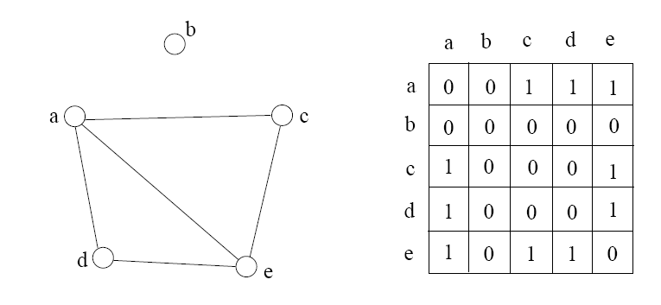
Adjacency Matrix
2D array A[0..n-1, 0..n-1], where n is the number of vertices in the graph
Each row and column is indexed by the vertex id
e,g a=0, b=1, c=2, d=3, e=4
A[i][j]=1 if there is an edge connecting vertices i and j; otherwise, A[i][j]=0
The storage requirement is Θ(n²). It is not efficient if the graph has few edges. An adjacency matrix is an appropriate representation if the graph is dense: |E|=Θ(|V|²)
We can detect in O(1) time whether two vertices are connected.

Slide 9
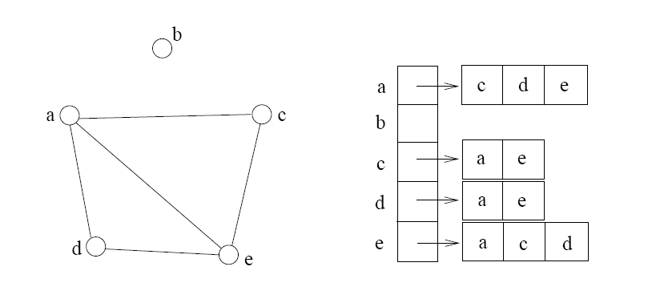
Adjacency List
If the graph is not dense, in other words, sparse, a better solution is an adjacency list
The adjacency list is an array A[0..n-1] of lists, where n is the number of vertices in the graph.
Each array entry is indexed by the vertex id
Each list A[i] stores the ids of the vertices adjacent to vertex i

Slide 10
Adjacency Matrix Example
0
 | 0 | 1 | 2 | 3 | 4 | 5 | 6 | 7 | 8 | 9
0 | 0 | 0 | 0 | 0 | 0 | 0 | 0 | 0 | 1 | 0
1 | 0 | 0 | 1 | 1 | 0 | 0 | 0 | 1 | 0 | 1
2 | 0 | 1 | 0 | 0 | 1 | 0 | 0 | 0 | 1 | 0
3 | 0 | 1 | 0 | 0 | 1 | 1 | 0 | 0 | 0 | 0
4 | 0 | 0 | 1 | 1 | 0 | 0 | 0 | 0 | 0 | 0
5 | 0 | 0 | 0 | 1 | 0 | 0 | 1 | 0 | 0 | 0
6 | 0 | 0 | 0 | 0 | 0 | 1 | 0 | 1 | 0 | 0
7 | 0 | 1 | 0 | 0 | 0 | 0 | 1 | 0 | 0 | 0
8 | 1 | 0 | 1 | 0 | 0 | 0 | 0 | 0 | 0 | 1
9 | 0 | 1 | 0 | 0 | 0 | 0 | 0 | 0 | 1 | 0
8
2
9
1
3
7
6
4
5

Slide 11
Adjacency List Example
0
0
1
2
3
4
5
6
7
8
9
8
2 | 3 | 7 | 9
8
1 | 4 | 8
2
9
1 | 4 | 5
1
2 | 3
7
3 | 6
3
6
5 | 7
4
5
1 | 6
0 | 2 | 9
1 | 8

Slide 12
Storage of Adjacency List
The array takes up Θ(n) space
Define degree of v, deg(v), to be the number of edges incident to v. Then, the total space to store the graph is proportional to:
An edge e={u,v} of the graph contributes a count of 1 to deg(u) and contributes a count 1 to deg(v)
Therefore, Σ_{vertex v}deg(v) = 2m, where m is the total number of edges
In all, the adjacency list takes up Θ(n+m) space
If m = O(n²) (i.e. dense graphs), both adjacent matrix and adjacent lists use Θ(n²) space.
If m = O(n), adjacent list outperform adjacent matrix
However, one cannot tell in O(1) time whether two vertices are connected

Slide 13
Adjacency List vs. Matrix
Adjacency List
More compact than adjacency matrices if graph has few edges
Requires more time to find if an edge exists
Adjacency Matrix
Always require n² space
This can waste a lot of space if the number of edges are sparse
Can quickly find if an edge exists

Slide 14
Path between Vertices
A path is a sequence of vertices (v₀, v₁, v₂,… v_{k}) such that:
For 0 ≤ i < k, {v_{i}, v_{i+1}} is an edge
Note: a path is allowed to go through the same vertex or the same edge any number of times!
The length of a path is the number of edges on the path

Slide 15
Types of paths
A path is simple if and only if it does not contain a vertex more than once.
A path is a cycle if and only if v₀= v_{k}
The beginning and end are the same vertex!
A path contains a cycle as its sub-path if some vertex appears twice or more

Slide 16
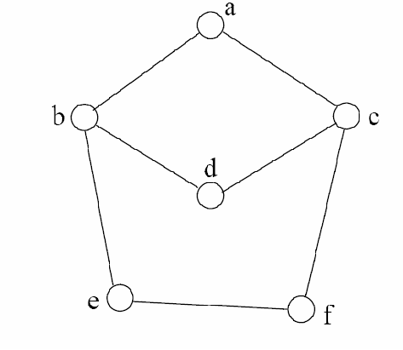
Path Examples
Are these paths?
Any cycles?
What is the path’s length?
{a,c,f,e}
{a,b,d,c,f,e}
{a, c, d, b, d, c, f, e}
{a,c,d,b,a}
{a,c,f,e,b,d,c,a}

Slide 17
Graph Traversal
Application example
Given a graph representation and a vertex s in the graph
Find all paths from s to other vertices
Two common graph traversal algorithms
Breadth-First Search (BFS)
Find the shortest paths in an unweighted graph
Depth-First Search (DFS)
Topological sort
Find strongly connected components

Slide 18
BFS and Shortest Path Problem
Given any source vertex s, BFS visits the other vertices at increasing distances away from s. In doing so, BFS discovers paths from s to other vertices
What do we mean by “distance”? The number of edges on a path from s
Example
0
Consider s=vertex 1
8
2
Nodes at distance 1?
2, 3, 7, 9
1
2
s
9
1
1
Nodes at distance 2?
8, 6, 5, 4
7
1
3
6
2
4
1
5
Nodes at distance 3?
0
2
2

Slide 19
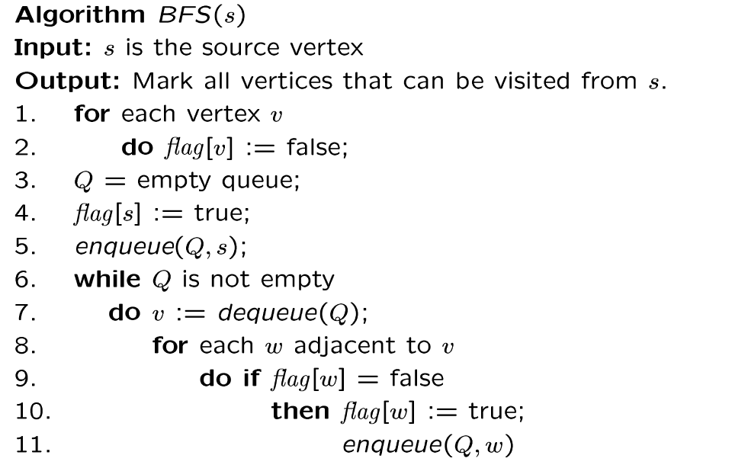
BFS Algorithm
// flag[ ]: visited table
Why use queue? Need FIFO

Slide 20
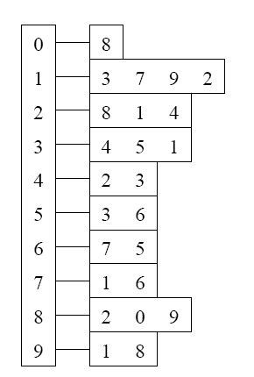
BFS Example
Adjacency List
Visited Table (T/F)
0
1
2
3
4
5
6
7
8
9
F
F
F
F
F
F
F
F
F
F
0
8
source
2
9
1
3
7
6
4
5
Initialize visited
table (all False)
Q =
{ }
Initialize Q to be empty

Slide 21
Adjacency List
Visited Table (T/F)
0
1
2
3
4
5
6
7
8
9
F
F
T
F
F
F
F
F
F
F
0
8
source
2
9
1
3
7
6
4
5
Flag that 2 has
been visited
Q =
{ 2 }
Place source 2 on the queue

Slide 22
Adjacency List
Visited Table (T/F)
0
1
2
3
4
5
6
7
8
9
F
T
T
F
T
F
F
F
T
F
0
8
Neighbors
source
2
9
1
3
7
6
4
5
Mark neighbors
as visited 1, 4, 8
Q =
{2} → { 8, 1, 4 }
Dequeue 2.
Place all unvisited neighbors of 2 on the queue

Slide 23
Adjacency List
Visited Table (T/F)
0
1
2
3
4
5
6
7
8
9
T
T
T
F
T
F
F
F
T
T
0
8
source
2
9
1
3
7
Neighbors
6
4
5
Mark new visited
Neighbors 0, 9
Q =
{ 8, 1, 4 } → { 1, 4, 0, 9 }
Dequeue 8.
-- Place all unvisited neighbors of 8 on the queue.
-- Notice that 2 is not placed on the queue again, it has been visited!

Slide 24
Adjacency List
Visited Table (T/F)
0
1
2
3
4
5
6
7
8
9
T
T
T
T
T
F
F
T
T
T
0
Neighbors
8
source
2
9
1
3
7
6
4
5
Mark new visited
Neighbors 3, 7
Q =
{ 1, 4, 0, 9 } → { 4, 0, 9, 3, 7 }
Dequeue 1.
-- Place all unvisited neighbors of 1 on the queue.
-- Only nodes 3 and 7 haven’t been visited yet.

Slide 25
Adjacency List
Visited Table (T/F)
0
1
2
3
4
5
6
7
8
9
T
T
T
T
T
F
F
T
T
T
0
8
source
2
9
Neighbors
1
3
7
6
4
5
Q =
{ 4, 0, 9, 3, 7 } → { 0, 9, 3, 7 }
Dequeue 4.
-- 4 has no unvisited neighbors!

Slide 26
Adjacency List
Visited Table (T/F)
Neighbors
0
1
2
3
4
5
6
7
8
9
T
T
T
T
T
F
F
T
T
T
0
8
source
2
9
1
3
7
6
4
5
Q =
{ 0, 9, 3, 7 } → { 9, 3, 7 }
Dequeue 0.
-- 0 has no unvisited neighbors!

Slide 27
Adjacency List
Visited Table (T/F)
0
1
2
3
4
5
6
7
8
9
T
T
T
T
T
F
F
T
T
T
0
8
source
2
9
1
3
7
6
4
5
Neighbors
Q =
{ 9, 3, 7 } → { 3, 7 }
Dequeue 9.
-- 9 has no unvisited neighbors!

Slide 28
Adjacency List
Visited Table (T/F)
0
1
2
3
4
5
6
7
8
9
T
T
T
T
T
T
F
T
T
T
0
8
Neighbors
source
2
9
1
3
7
6
4
5
Mark new visited
Vertex 5
Q =
{ 3, 7 } → { 7, 5 }
Dequeue 3.
-- place neighbor 5 on the queue.

Slide 29
Adjacency List
Visited Table (T/F)
0
1
2
3
4
5
6
7
8
9
T
T
T
T
T
T
T
T
T
T
0
8
source
2
9
1
7
Neighbors
3
6
4
5
Mark new visited
Vertex 6
Q =
{ 7, 5 } → { 5, 6 }
Dequeue 7.
-- place neighbor 6 on the queue

Slide 30
Adjacency List
Visited Table (T/F)
0
1
2
3
4
5
6
7
8
9
T
T
T
T
T
T
T
T
T
T
0
8
source
2
9
Neighbors
1
3
7
6
4
5
Q =
{ 5, 6} → { 6 }
Dequeue 5.
-- no unvisited neighbors of 5

Slide 31
Adjacency List
Visited Table (T/F)
0
1
2
3
4
5
6
7
8
9
T
T
T
T
T
T
T
T
T
T
0
8
source
2
9
1
Neighbors
3
7
6
4
5
Q =
{ 6 } → { }
Dequeue 6.
-- no unvisited neighbors of 6

Slide 32
Adjacency List
Visited Table (T/F)
0
1
2
3
4
5
6
7
8
9
T
T
T
T
T
T
T
T
T
T
0
8
source
2
9
1
3
7
6
4
5
What did we discover?
Look at “visited” tables.
There exists a path from source
vertex 2 to all vertices in the graph
Q =
{ }
STOP!!! Q is empty!!!

Slide 33
Time Complexity of BFS (Using Adjacency List)
Assume adjacency list
n = number of vertices m = number of edges
O(n + m)
Each vertex will enter Q at most once.
Each iteration takes time proportional to deg(v) + 1 (the number 1 is to account for the case where deg(v) = 0 --- the work required is 1, not 0).

Slide 34
Running Time
Recall: Given a graph with m edges, what is the total degree?
The total running time of the while loop is:
this is summing over all the iterations in the while loop!
Σ_{vertex v} deg(v) = 2m
O( Σ_{vertex v} (deg(v) + 1) ) = O(n+m)

Slide 35
Time Complexity of BFS (Using Adjacency Matrix)
Assume adjacency list
n = number of vertices m = number of edges
O(n²)
Finding the adjacent vertices of v requires checking all elements in the row. This takes linear time O(n).
Summing over all the n iterations, the total running time is O(n²).
So, with adjacency matrix, BFS is O(n²) independent of the number of edges m.
With adjacent lists, BFS is O(n+m); if m=O(n²) like in a dense graph, O(n+m)=O(n²).

Slide 36
Breadth First Search (BFS) Part 2
COMP171
Fall 2006
Lecture 23

Slide 37
Shortest Path Recording
BFS we saw only tells us whether a path exists from source s, to other vertices v.
It doesn’t tell us the path!
We need to modify the algorithm to record the path
How can we do that?
Note: we do not know which vertices lie on this path until we reach v!
Efficient solution:
Use an additional array pred[0..n-1]
Pred[w] = v means that vertex w was visited from v

Slide 38
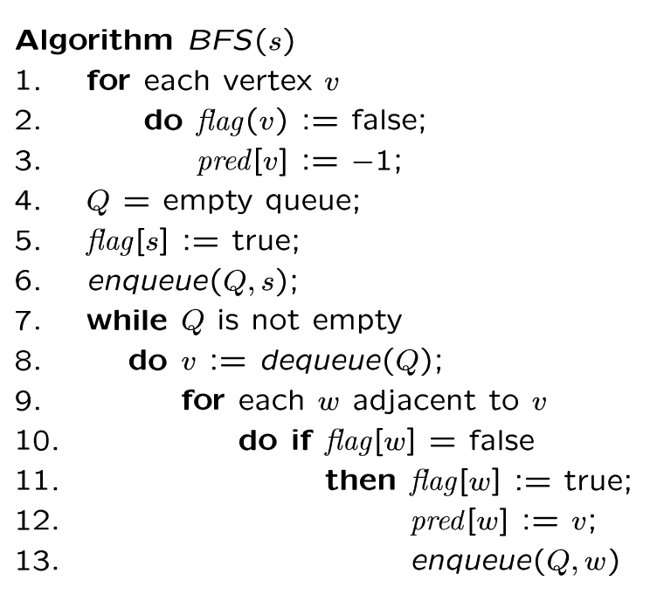
BFS + Path Finding
initialize all pred[v] to -1
Record where you came from

Slide 39
Example
Visited Table (T/F)
Adjacency List
0
1
2
3
4
5
6
7
8
9
F
F
F
F
F
F
F
F
F
F
-
-
-
-
-
-
-
-
-
-
0
8
source
2
9
1
3
7
6
4
5
Pred
Initialize visited
table (all False)
Initialize Pred to -1
Q =
{ }
Initialize Q to be empty

Slide 40
Adjacency List
Visited Table (T/F)
0
1
2
3
4
5
6
7
8
9
F
F
T
F
F
F
F
F
F
F
-
-
-
-
-
-
-
-
-
-
0
8
source
2
9
1
3
7
6
4
5
Pred
Flag that 2 has
been visited.
Q =
{ 2 }
Place source 2 on the queue.

Slide 41
Adjacency List
Visited Table (T/F)
0
1
2
3
4
5
6
7
8
9
F
T
T
F
T
F
F
F
T
F
-
2
-
-
2
-
-
-
2
-
0
8
Neighbors
source
2
9
1
3
7
6
4
5
Pred
Mark neighbors
as visited.
Record in Pred
that we came from 2.
Q =
{2} → { 8, 1, 4 }
Dequeue 2.
Place all unvisited neighbors of 2 on the queue

Slide 42
Adjacency List
Visited Table (T/F)
0
1
2
3
4
5
6
7
8
9
T
T
T
F
T
F
F
F
T
T
8
2
-
-
2
-
-
-
2
8
0
8
source
2
9
1
3
7
Neighbors
6
4
5
Pred
Mark new visited
Neighbors.
Record in Pred
that we came from 8.
Q =
{ 8, 1, 4 } → { 1, 4, 0, 9 }
Dequeue 8.
-- Place all unvisited neighbors of 8 on the queue.
-- Notice that 2 is not placed on the queue again, it has been visited!

Slide 43
Adjacency List
Visited Table (T/F)
0
1
2
3
4
5
6
7
8
9
T
T
T
T
T
F
F
T
T
T
8
2
-
1
2
-
-
1
2
8
0
Neighbors
8
source
2
9
1
3
7
6
4
5
Pred
Mark new visited
Neighbors.
Record in Pred
that we came from 1.
Q =
{ 1, 4, 0, 9 } → { 4, 0, 9, 3, 7 }
Dequeue 1.
-- Place all unvisited neighbors of 1 on the queue.
-- Only nodes 3 and 7 haven’t been visited yet.

Slide 44
Adjacency List
Visited Table (T/F)
0
1
2
3
4
5
6
7
8
9
T
T
T
T
T
F
F
T
T
T
8
2
-
1
2
-
-
1
2
8
0
8
2
Neighbors
source
9
1
3
7
6
4
5
Pred
Q =
{ 4, 0, 9, 3, 7 } → { 0, 9, 3, 7 }
Dequeue 4.
-- 4 has no unvisited neighbors!

Slide 45
Adjacency List
Visited Table (T/F)
Neighbors
0
1
2
3
4
5
6
7
8
9
T
T
T
T
T
F
F
T
T
T
8
2
-
1
2
-
-
1
2
8
0
8
source
2
9
1
3
7
6
4
5
Pred
Q =
{ 0, 9, 3, 7 } → { 9, 3, 7 }
Dequeue 0.
-- 0 has no unvisited neighbors!

Slide 46
Adjacency List
Visited Table (T/F)
0
1
2
3
4
5
6
7
8
9
T
T
T
T
T
F
F
T
T
T
8
2
-
1
2
-
-
1
2
8
0
8
source
2
9
1
3
7
6
4
5
Neighbors
Pred
Q =
{ 9, 3, 7 } → { 3, 7 }
Dequeue 9.
-- 9 has no unvisited neighbors!

Slide 47
Adjacency List
Visited Table (T/F)
0
1
2
3
4
5
6
7
8
9
T
T
T
T
T
T
F
T
T
T
8
2
-
1
2
3
-
1
2
8
0
8
Neighbors
source
2
9
1
3
7
6
4
5
Pred
Mark new visited
Vertex 5.
Record in Pred
that we came from 3.
Q =
{ 3, 7 } → { 7, 5 }
Dequeue 3.
-- place neighbor 5 on the queue.

Slide 48
Adjacency List
Visited Table (T/F)
0
1
2
3
4
5
6
7
8
9
T
T
T
T
T
T
T
T
T
T
8
2
-
1
2
3
7
1
2
8
0
8
source
2
9
1
7
Neighbors
3
6
4
5
Pred
Mark new visited
Vertex 6.
Record in Pred
that we came from 7.
Q =
{ 7, 5 } → { 5, 6 }
Dequeue 7.
-- place neighbor 6 on the queue.

Slide 49
Adjacency List
Visited Table (T/F)
0
1
2
3
4
5
6
7
8
9
T
T
T
T
T
T
T
T
T
T
8
2
-
1
2
3
7
1
2
8
0
8
source
2
9
Neighbors
1
3
7
6
4
5
Pred
Q =
{ 5, 6} → { 6 }
Dequeue 5.
-- no unvisited neighbors of 5.

Slide 50
Adjacency List
Visited Table (T/F)
0
1
2
3
4
5
6
7
8
9
T
T
T
T
T
T
T
T
T
T
8
2
-
1
2
3
7
1
2
8
0
8
source
2
9
1
Neighbors
3
7
6
4
5
Pred
Q =
{ 6 } → { }
Dequeue 6.
-- no unvisited neighbors of 6.

Slide 51
BFS Finished
Adjacency List
Visited Table (T/F)
0
1
2
3
4
5
6
7
8
9
T
T
T
T
T
T
T
T
T
T
8
2
-
1
2
3
7
1
2
8
0
8
source
2
9
1
3
7
6
4
5
Pred
Pred now can be traced backward
to report the path!
Q =
{ }
STOP!!! Q is empty!!!

Slide 52
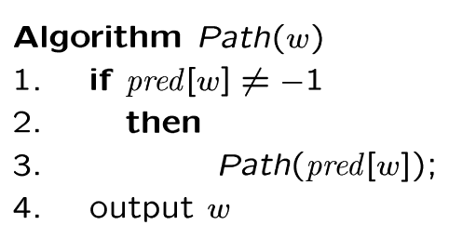
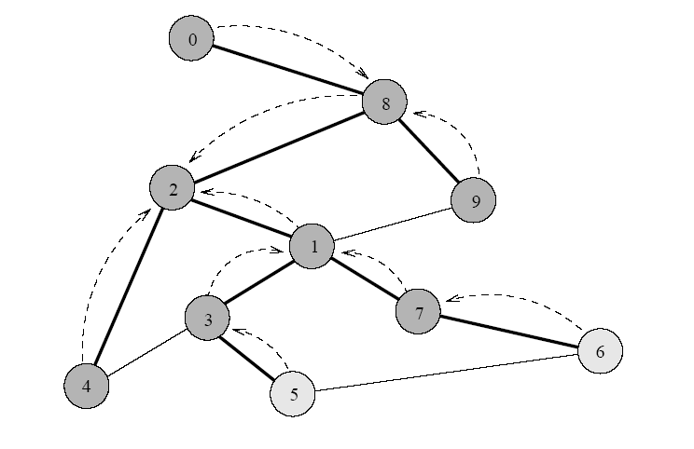
Path Reporting
nodes
visited from
0
1
2
3
4
5
6
7
8
9
8
2
-
1
2
3
7
1
2
8
Recursive algorithm
Try some examples, report path from s to v:
Path(0) ->
Path(6) ->
Path(1) ->
The path returned is the shortest from s to v (minimum number of edges).

Slide 53
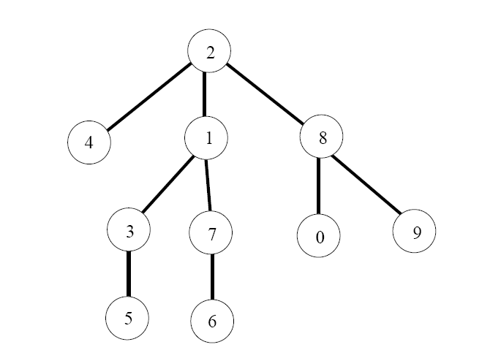
BFS Tree
The paths found by BFS is often drawn as a rooted tree (called BFS tree), with the starting vertex as the root of the tree.
BFS tree for vertex s=2.
Question: What would a “level” order traversal tell you?

Slide 54
Record the Shortest Distance
d(v) = ∞;
d(s) = 0;
d(w)=d(v)+1;

Slide 55
Application of BFS
One application concerns how to find
connected components in a graph
If a graph has more than one connected components, BFS builds a BFS-forest (not just BFS-tree)!
Each tree in the forest is a connected component.

Slide 56
Depth-First Search
COMP171
Fall 2006
Lecture 24

Slide 57
Depth-First Search (DFS)
DFS is another popular graph search strategy
Idea is similar to pre-order traversal (visit node, then visit children recursively)
DFS can provide certain information about the graph that BFS cannot
It can tell whether we have encountered a cycle or not

Slide 58
DFS Algorithm
DFS will continue to visit neighbors in a recursive pattern
Whenever we visit v from u, we recursively visit all unvisited neighbors of v. Then we backtrack (return) to u.
Note: it is possible that w2 was unvisited when we recursively visit w1, but became visited by the time we return from the recursive call.
u
v
w3
w1
w2

Slide 59
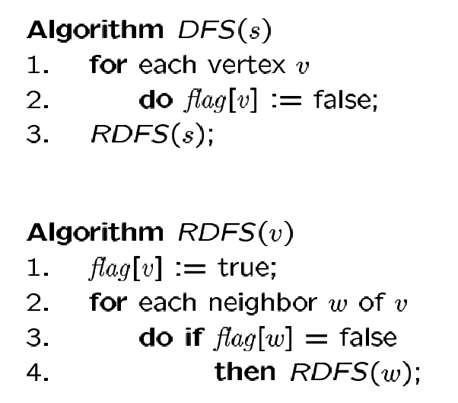
DFS Algorithm
Flag all vertices as not visited
Flag yourself as visited
For unvisited neighbors, call RDFS(w) recursively
We can also record the paths using pred[ ].

Slide 60
Example
Adjacency List
Visited Table (T/F)
0
0
1
2
3
4
5
6
7
8
9
F
F
F
F
F
F
F
F
F
F
-
-
-
-
-
-
-
-
-
-
8
source
2
9
1
3
7
6
4
5
Pred
Initialize visited
table (all False)
Initialize Pred to -1

Slide 61
Adjacency List
Visited Table (T/F)
0
0
1
2
3
4
5
6
7
8
9
F
F
T
F
F
F
F
F
F
F
-
-
-
-
-
-
-
-
-
-
8
source
2
9
1
3
7
6
4
5
Pred
Mark 2 as visited
RDFS( 2 )
Now visit RDFS(8)

Slide 62
Adjacency List
Visited Table (T/F)
0
8
0
1
2
3
4
5
6
7
8
9
F
F
T
F
F
F
F
F
T
F
-
-
-
-
-
-
-
-
2
-
source
2
9
1
3
7
6
4
5
Pred
Mark 8 as visited
mark Pred[8]
Recursive calls
RDFS( 2 )
RDFS(8)
2 is already visited, so visit RDFS(0)

Slide 63
Adjacency List
Visited Table (T/F)
0
8
0
1
2
3
4
5
6
7
8
9
T
F
T
F
F
F
F
F
T
F
8
-
-
-
-
-
-
-
2
-
source
2
9
1
3
7
6
4
5
Pred
Mark 0 as visited
Mark Pred[0]
Recursive calls
RDFS( 2 )
RDFS(8)
RDFS(0) -> no unvisited neighbors, return
to call RDFS(8)

Slide 64
Back to 8
Adjacency List
Visited Table (T/F)
0
8
0
1
2
3
4
5
6
7
8
9
T
F
T
F
F
F
F
F
T
F
8
-
-
-
-
-
-
-
2
-
source
2
9
1
3
7
6
4
5
Pred
Recursive calls
RDFS( 2 )
RDFS(8)
Now visit 9 -> RDFS(9)

Slide 65
Adjacency List
Visited Table (T/F)
0
8
0
1
2
3
4
5
6
7
8
9
T
F
T
F
F
F
F
F
T
T
8
-
-
-
-
-
-
-
2
8
source
2
9
1
3
7
6
4
5
Pred
Mark 9 as visited
Mark Pred[9]
Recursive calls
RDFS( 2 )
RDFS(8)
RDFS(9)
-> visit 1, RDFS(1)

Slide 66
Adjacency List
Visited Table (T/F)
0
8
0
1
2
3
4
5
6
7
8
9
T
T
T
F
F
F
F
F
T
T
8
9
-
-
-
-
-
-
2
8
source
2
9
1
3
7
6
4
5
Pred
Mark 1 as visited
Mark Pred[1]
Recursive calls
RDFS( 2 )
RDFS(8)
RDFS(9)
RDFS(1)
visit RDFS(3)

Slide 67
Adjacency List
Visited Table (T/F)
0
8
0
1
2
3
4
5
6
7
8
9
T
T
T
T
F
F
F
F
T
T
8
9
-
1
-
-
-
-
2
8
source
2
9
1
3
7
6
4
5
Pred
Mark 3 as visited
Mark Pred[3]
Recursive calls
RDFS( 2 )
RDFS(8)
RDFS(9)
RDFS(1)
RDFS(3)
visit RDFS(4)

Slide 68
Adjacency List
Visited Table (T/F)
0
8
0
1
2
3
4
5
6
7
8
9
T
T
T
T
T
F
F
F
T
T
8
9
-
1
3
-
-
-
2
8
source
2
9
1
3
7
6
4
5
Pred
RDFS( 2 )
RDFS(8)
RDFS(9)
RDFS(1)
RDFS(3)
RDFS(4) → STOP all of 4’s neighbors have been visited
return back to call RDFS(3)
Mark 4 as visited
Mark Pred[4]
Recursive calls

Slide 69

Adjacency List
Visited Table (T/F)
0
8
0
1
2
3
4
5
6
7
8
9
T
T
T
T
T
F
F
F
T
T
8
9
-
1
3
-
-
-
2
8
source
2
9
1
3
7
6
4
5
Back to 3
Pred
RDFS( 2 )
RDFS(8)
RDFS(9)
RDFS(1)
RDFS(3)
visit 5 -> RDFS(5)
Recursive calls

Slide 70
Adjacency List
Visited Table (T/F)
0
8
0
1
2
3
4
5
6
7
8
9
T
T
T
T
T
T
F
F
T
T
8
9
-
1
3
3
-
-
2
8
source
2
9
1
3
7
6
4
5
Pred
RDFS( 2 )
RDFS(8)
RDFS(9)
RDFS(1)
RDFS(3)
RDFS(5)
3 is already visited, so visit 6 -> RDFS(6)
Recursive calls
Mark 5 as visited
Mark Pred[5]

Slide 71
Adjacency List
Visited Table (T/F)
0
8
0
1
2
3
4
5
6
7
8
9
T
T
T
T
T
T
T
F
T
T
8
9
-
1
3
3
5
-
2
8
source
2
9
1
3
7
6
4
5
RDFS( 2 )
RDFS(8)
RDFS(9)
RDFS(1)
RDFS(3)
RDFS(5)
RDFS(6)
visit 7 -> RDFS(7)
Pred
Recursive calls
Mark 6 as visited
Mark Pred[6]

Slide 72
Adjacency List
Visited Table (T/F)
0
8
0
1
2
3
4
5
6
7
8
9
T
T
T
T
T
T
T
T
T
T
8
9
-
1
3
3
5
6
2
8
source
2
9
1
3
7
6
4
5
Pred
RDFS( 2 )
RDFS(8)
RDFS(9)
RDFS(1)
RDFS(3)
RDFS(5)
RDFS(6)
RDFS(7) -> Stop no more unvisited neighbors
Recursive calls
Mark 7 as visited
Mark Pred[7]

Slide 73
Adjacency List
Visited Table (T/F)
0
0
1
2
3
4
5
6
7
8
9
T
T
T
T
T
T
T
T
T
T
8
9
-
1
3
3
5
6
2
8
8
source
2
9
1
3
7
6
4
5
RDFS( 2 )
RDFS(8)
RDFS(9)
RDFS(1)
RDFS(3)
RDFS(5)
RDFS(6) -> Stop
Pred
Recursive calls

Slide 74
Adjacency List
Visited Table (T/F)
0
0
1
2
3
4
5
6
7
8
9
T
T
T
T
T
T
T
T
T
T
8
9
-
1
3
3
5
6
2
8
8
source
2
9
1
3
7
6
4
5
RDFS( 2 )
RDFS(8)
RDFS(9)
RDFS(1)
RDFS(3)
RDFS(5) -> Stop
Pred
Recursive calls

Slide 75
Adjacency List
Visited Table (T/F)
0
0
1
2
3
4
5
6
7
8
9
T
T
T
T
T
T
T
T
T
T
8
9
-
1
3
3
5
6
2
8
8
source
2
9
1
3
7
6
4
5
RDFS( 2 )
RDFS(8)
RDFS(9)
RDFS(1)
RDFS(3) -> Stop
Pred
Recursive calls

Slide 76
Adjacency List
Visited Table (T/F)
0
0
1
2
3
4
5
6
7
8
9
T
T
T
T
T
T
T
T
T
T
8
9
-
1
3
3
5
6
2
8
8
source
2
9
1
3
7
6
4
5
RDFS( 2 )
RDFS(8)
RDFS(9)
RDFS(1) -> Stop
Pred
Recursive calls

Slide 77
Adjacency List
Visited Table (T/F)
0
0
1
2
3
4
5
6
7
8
9
T
T
T
T
T
T
T
T
T
T
8
9
-
1
3
3
5
6
2
8
8
source
2
9
1
3
7
6
4
5
RDFS( 2 )
RDFS(8)
RDFS(9) -> Stop
Pred
Recursive calls

Slide 78
Adjacency List
Visited Table (T/F)
0
0
1
2
3
4
5
6
7
8
9
T
T
T
T
T
T
T
T
T
T
8
9
-
1
3
3
5
6
2
8
8
source
2
9
1
3
7
6
4
5
RDFS( 2 )
RDFS(8) -> Stop
Pred
Recursive calls

Slide 79
Example Finished
Adjacency List
Visited Table (T/F)
0
0
1
2
3
4
5
6
7
8
9
T
T
T
T
T
T
T
T
T
T
8
9
-
1
3
3
5
6
2
8
8
source
2
9
1
3
7
6
4
5
RDFS( 2 ) -> Stop
Pred
Recursive calls finished

Slide 80
DFS Path Tracking
0
Adjacency List
Visited Table (T/F)
8
0
1
2
3
4
5
6
7
8
9
T
T
T
T
T
T
T
T
T
T
8
9
-
1
3
3
5
6
2
8
source
2
9
1
3
7
6
4
5
DFS find out path too
Pred
Try some examples.
Path(0) ->
Path(6) ->
Path(7) ->

Slide 81
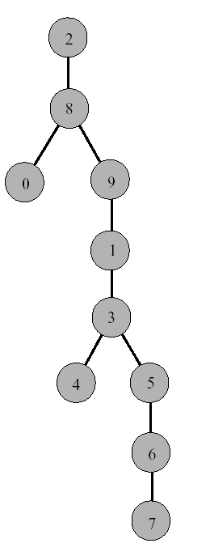
DFS Tree
Resulting DFS-tree.
Notice it is much “deeper”
than the BFS tree.
Captures the structure of the recursive calls
when we visit a neighbor w of v, we add w as child of v
whenever DFS returns from a vertex v, we climb up in the tree from v to its parent

Slide 82
Time Complexity of DFS (Using adjacency list)
We never visited a vertex more than once
We had to examine all edges of the vertices
We know Σ_{vertex v} degree(v) = 2m where m is the number of edges
So, the running time of DFS is proportional to the number of edges and number of vertices (same as BFS)
O(n + m)
You will also see this written as:
O(|v|+|e|) |v| = number of vertices (n) |e| = number of edges (m)

